Slide 1
RF Exposure – Evaluating Your Station – by Ed, N3US
Presentation to AARC on Aug 11, 2020
Major source of material from HamRadioSchool.com with permission

Slide 2
The FCC Regulations
The requirement to conduct RF exposure evaluation is described in FCC regulation §97.13
It provides a table of all amateur radio bands with transmitted power levels in watts for each band
RF environmental evaluation must be performed if the station’s power into the antenna exceeds the table value for the band of operation
Power into the antenna is specified as peak envelope power (PEP).
Notes:
<number>

Slide 3
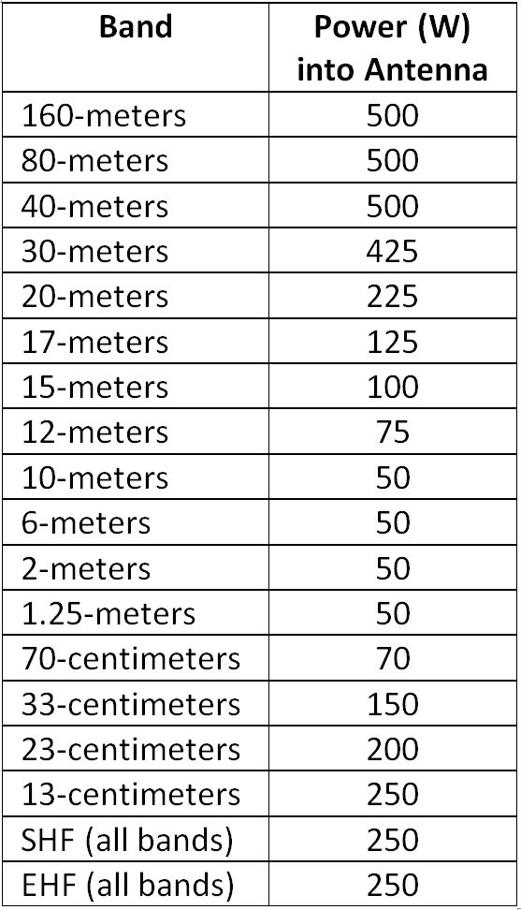
Power into antenna which requires safety evaluation

Slide 4
Is Evaluation Required?
Determine the maximum power output of your transmitter for the band, in units of Watts PEP.
Determine power loss in decibels (dB) of transmission line.
Calculate resulting maximum power input to the antenna, PEP
Compare antenna input PEP with the maximum permitted value for band
If Evaluation is required, we turn to FCC OET Bulletin 65: Evaluating Compliance with FCC Guidelines for Human Exposure To Radiofrequency Electromagnetic Fields
This permits use of 3 methods

Slide 5
The Three Methods:
By calculation based on FCC OET Bulletin 65 – simple and method we will use
By calculation based on computer modeling – a bit more complicated
By measurement of field strength using calibrated equipment – calibrated test equipment is expensive

Slide 6
Maximum Permissible Exposure (MPE) Limits
Human body absorbs RF energy with variable efficiency based upon frequency.
RF energy is non-ionzing radiation, heats bodily tissues and can cause health hazards if exposure level is too great.
FCC OET bulletin specifies maximum allowable power density of any given frequency in milliwatts per square centimeter (mW/cm²)
One MPE value for Occupational/Controlled spaces (applies to the Ham operators) and lower MPE value for General population/uncontrolled spaces (applies to family members, neighbors, visitors, etc).
Uncontrolled space is more stringent meaning lower mW/cm²

Slide 7
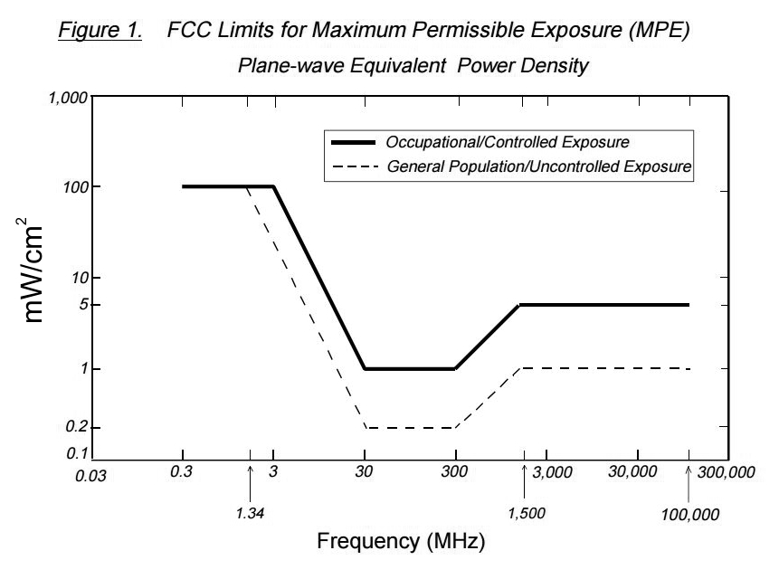

Slide 8
Factors Affecting Exposure
Average Power at antenna accounting for: coax loss. duty cycle, and average transmit time over 30-minute period
Antenna gain referenced to isotropic source
Operating frequency
Distance to area of interest

Slide 9
EXAMPLE
So say for our frequency of interest the MPE is I mw/CM² for the Controlled space (the ham) and for the uncontrolled space (such as a child sleeping upstairs, closer to the antenna) the MPE is 0.2 mw/CM²)
We calculate the distance from the antenna to our station AND from our antenna to our child's bedroom using the same formula but with a different distances to see if we are compliant. It is possible that we may be compliant for our shack but not for the bedroom.

Slide 10
Two Easy to Use Exposure Calculators
https://hamradioschool.com/rf-exposure-calculator/
http://hintlink.com/power_density.htm

Slide 11
Take steps to mitigate the possibility of exceeding MPE, as necessary:
Relocate or elevate antenna – anyway, the higher the antenna the better its performance
Restrict antenna pointing directions
Restrict frequency/band use
Restrict mode use
Reduce PEP into the antenna – always great operating practice to run minimum power required
Restrict station operation times

