Slide 1
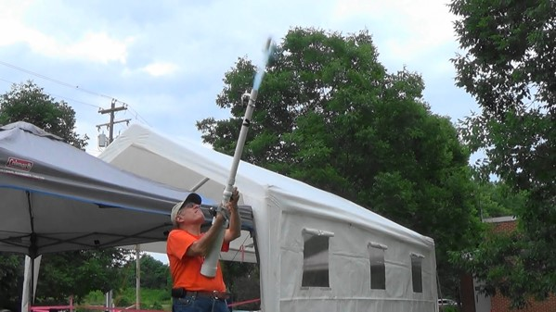
How to build an air launcher in a couple of easy steps.

Slide 2
Parts list
ITEM LOWES # BAR CODE COST
3” End Cap 23926 6 11942 03858 9 $4.68
3”x2’ PVC Pipe 294917 6 11942 11275 3 $5.22
3”x1.5” Adapter 23319 6 11942 03204 4 $3.88
1.5”x1” Reducer 49925 0 25528 13468 6 $2.38
1’x1’ Nipple 56860 0 25528 11895 2 $0.92
1” Valve Threaded 21485 6 11918 00906 3 $5.48
1”x1.25” Adapter 49925 0 25528 13180 7 $2.38
1.25”x2’ PVC Pipe 350966 7 17141 28123 5 $2.98
¾”x18” PVC Pipe 7 17141 28073 3

Slide 3
PARTS LIST
¾” End Caps 23896 0 25528 13680 $0.69 (8-10 needed)
Pressure valve (used in water tanks) 1/8” NPT #955580 $10.98
Pressure gage 0-100 PSI ¼”NPT or 1/8 NPT $12.00
Teflon Tape and/or pipe thread sealant
Small eye hooks (4-6 needed)
Fishing swivel’s
ZEBCO 33 Reel Amazon $12.95
PVC Cleaner
PVC Glue

Slide 4
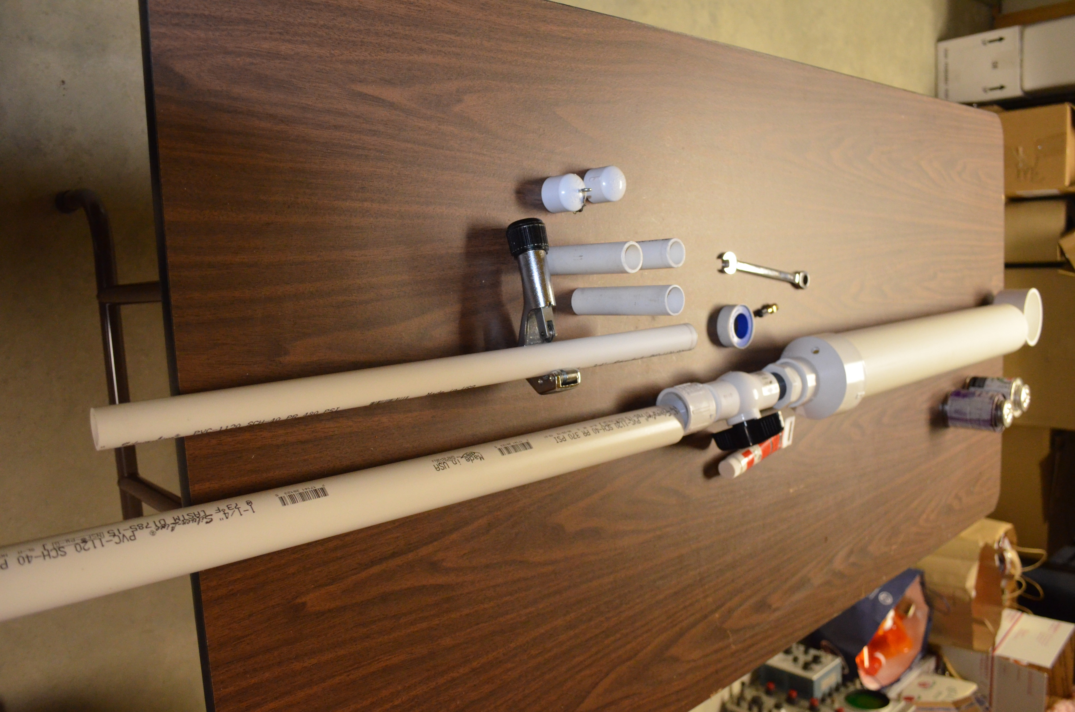
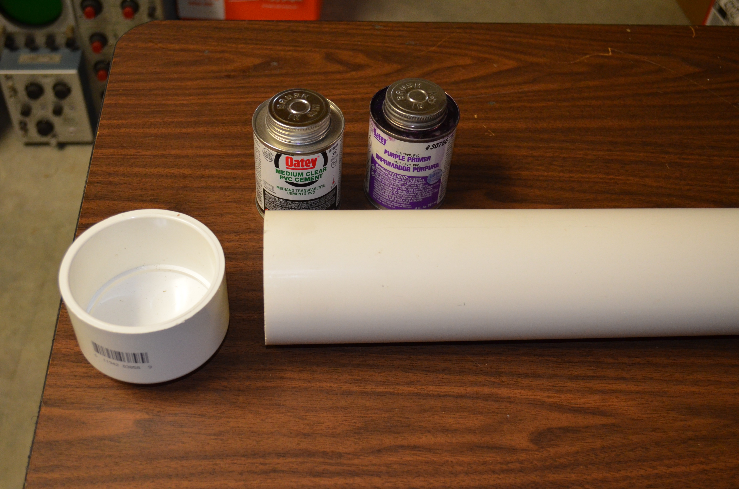

Slide 5
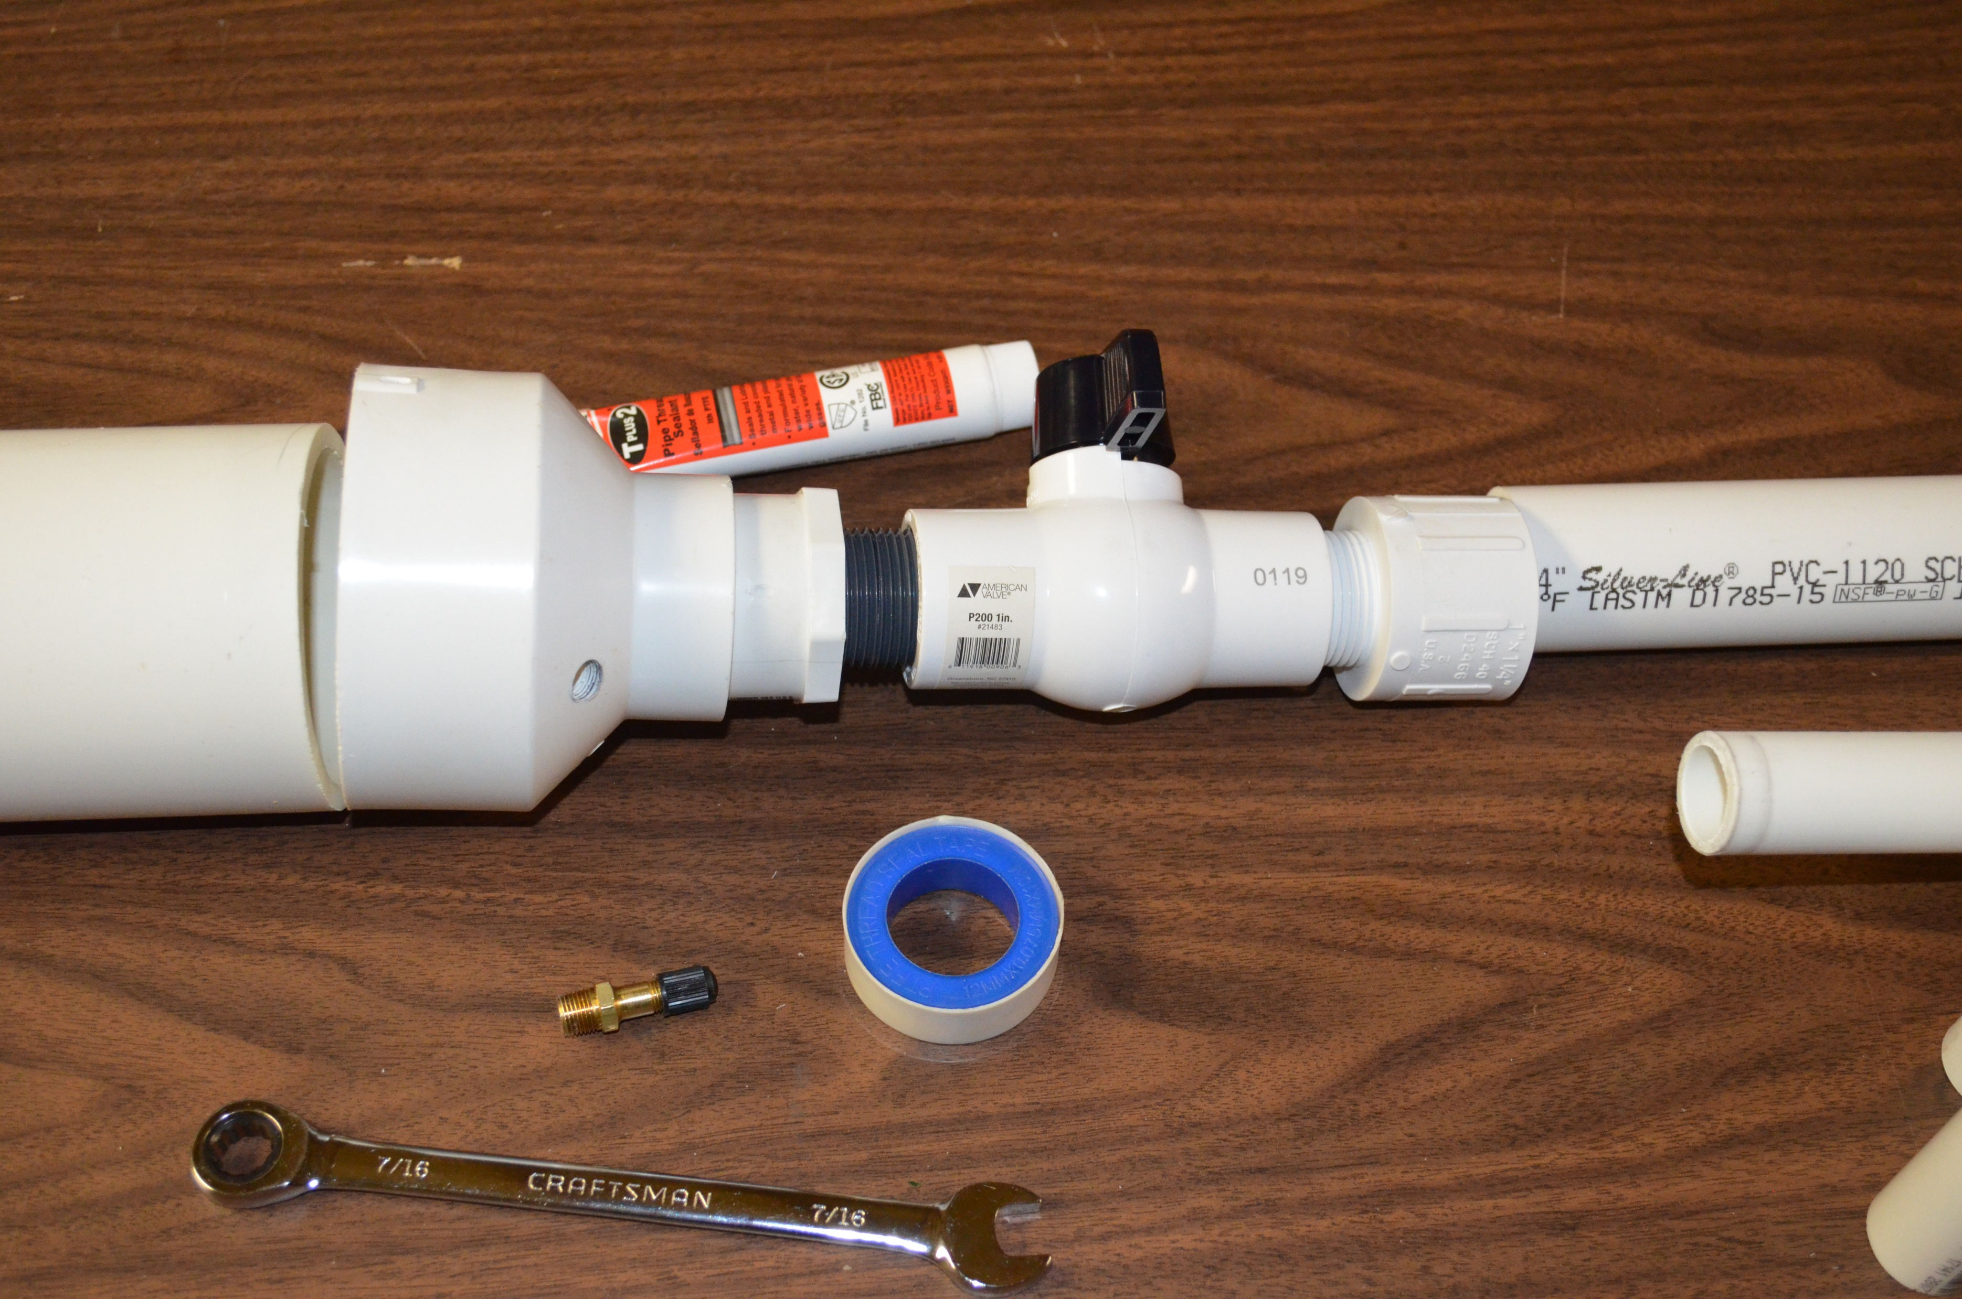

Slide 6
