Slide 1
Ticks and mosquitoes are gonna have a field day And how you can frustrate them
Albemarle Amateur Radio Club
July 8, 2016
Michael F. Rein, MD
KA4JJD

Slide 2
What, bugs again?
Ticks:
“The summer of 2016 may turn out to be the worst year ever for Lyme disease….”
Geography of Lyme spreading south
We have always had a problem with Rocky Mountain spotted fever, tularemia, and Ehrlichiosis
Mosquitoes:
Not this year, but soon, also worry about Zika, Dengue, and Chikungunya
We have always had a problem with West Nile and some of the arbovirus encephalidities

Slide 3
I will only discuss prevention Almost everything is in the handout
I am happy to discuss other aspects of these diseases over a beer (you buy)

Slide 4
Why some hams have trouble with ticks: Very little problem with well-mown grass Courtesy K4JEC

Slide 5
Tick City: Marshall Manor 2013 Courtesy AK4OL

Slide 6
Five messages
Avoid ticks and mosquitoes
Do careful tick checks
Remove ticks carefully
Follow bite site for several days
Remain alert for fevers with or without rashes after exposure

Slide 7
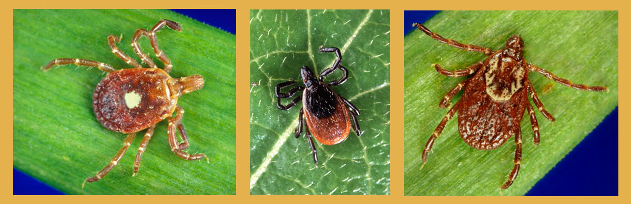
Common Virginia Ticks
Lone Star Tick
Blacklegged Tick
American Dog Tick
Notes:
There are three different tick species that commonly bite people in Virginia (lone star tick, blacklegged tick, and American dog tick).
The most common species to bite people in Virginia is the lone star tick. All three tick species can transmit various diseases, but only one species, the blacklegged tick (a.k.a., deer tick, latin name Ixodes scapularis) transmits Lyme disease. It is the only human biting tick in Virginia with black legs.
The VDH brochure “Preventing Tick-borne Diseases in Virginia” provides information on the other tick-borne diseases and is available on the website at http://www.vdh.virginia.gov/epidemiology/DEE/Vectorborne/TickBrochure.pdf

Slide 8
Some things to know about Virginia’s ticks
Lone star tick most common
Only female has star, male does not
Ehrlichiosis, some RMSF
Bite can cause allergy to beef and pork: “delayed anaphylaxis”
galactose-alpha-1,3-galactose
Dog tick: only the adult female bites
Rocky Mountain Spotted Fever
Anaplasmosis
Only the black leg tick (aka deer tick)
Lyme disease
It is the only tick with black legs (all stages)
Nymph is the major biter

Slide 9
Comparative sizes of ticks

Slide 10
Aedes aegypti

Slide 11
Aedes albopictus

Slide 12
Culex (dawn or after dusk)

Slide 13
Style tips for the bug-averse
Long sleeved shirts and long pants
Bug repellant on clothes
Light-colored clothing (makes ticks easier to spot)
Tuck pants into socks/boots
Ticks start on your shoes and crawl up
If your pants are tucked in, they have to work harder and are more exposed to permethrin

Slide 14
Permethrin
Synthetic version of chrysanthemum chemical
Insecticide not repellent
Fast enough to prevent bites?
Permethrin-sprayed clothing not as effect as Deet-sprayed clothing
Commercially-available clothing
Apparently lasts through 60 washings
Interlandi J: Consumer Reports 2016, May 26, epub

Slide 15
Insect repellents - 1
DEET:
~ 30% (e.g. Deep Woods Off®)
Traditionally considered the best bet
Now known to be less toxic than previously thought
Can be topical irritant for some people
Apply to exposed skin

Slide 16
Insect repellents - 2
Picardin 20%
Consumer Reports (April 2016): Equal to DEET in repelling ticks and mosquitoes
Sawyer Fisherman’s Formula Picardin®
Lemon-Eucalyptus: probably less effective against ticks
Repel Lemon Eucalyptus®
Repel Scented Family®
Natrepel 8 hour®

Slide 17
Afterward
Remove clothing promptly: Do wait until you get home
Careful tick check
Better (and can be more fun) with help
Especially: thigh, groin, axilla
Remember scalp
Launder clothing
Bathe within 2 hours: this also has esthetic advantages
Gentle removal: RMSF, tularemia contracted by squishing
Circle tick bite and follow daily

Slide 18
Brad Paisley: Ticks (Courtesy KT4UO)
“ ‘cause I’d like to see you out in the moonlight I’d like to kiss you way back in the sticks I’d like to walk you through a field of wildflowers and I’d like to check you for ticks”
“oooh you never know where one might be and oooh there’s lots of places that are hard to reach”
http://www.youtube.com/watch?v=G--JyVxZmGQ

Slide 19
Why promptness is a virtue
Ticks must be attached for:
24-48 hours for Lyme
Animal studies
Extensive human anecdotes: The plural of anecdote is anecdotes, not data
Understand the physiology
24 hours for Ehrlichiosis and Anaplasmosis
6 hours for Rocky Mountain Spotted Fever

Slide 20
Remove ticks promptly and properly
Use pointed tweezers to grasp the tick by the head; do not squeeze its body!
Pull slowly and steadily until the tick releases; do not jerk or twist the tick.
Notes:
A. Careful tick removal reduces the chance of disease transmission.
B. Do not squeeze the tick’s body - removal must be done carefully to prevent tick from regurgitating into the wound.
C. Do not jerk or twist the tick out – this may cause tick mouthparts to break off and remain in the wound.
D. We recommend saving the tick in a jar of alcohol so you can properly identify it. VDH can assist with identifying the tick if needed (you may use the “Tick Identification Chart” in the “Preventing Tick-borne Diseases” brochure or look up Dr. Gaines contact info on the VDH website to have him assist with tick identifications).

Slide 21
Tick Removal

Slide 22
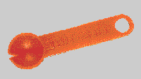
Evaluation of Three Commercial Tick Removal Tools Richard L. Stewart Jr, Willy Burgdorfer and Glen R.Needham Wilderness and Environmental Medicine, 9, 137-142 (1998)

Slide 23
Some points about tick removal
Grip tick as close to skin as possible
Pull gently but consistently for ~2 minutes
K4JEC: “Gently convince the tick that it will either let go or will lose its head”
If head does come off, just leave in place
Do not!!
Apply petroleum jelly
Apply lighter fluid or ether
Apply a lighted cigarette or the antenna tip of a keyed-down HT
Definitely do not apply lighter fluid or ether and then apply a lighted cigarette
Do not squeeze the tick

Slide 24
Not so easy: “Tight as a tick”
“Extremely close with one’s money. If you have every tried to separate a tick from an animal or some person’s skin, you know what ‘tight’ is.”
J. Rogers: The Dictionary of Cliches, New York, Random House, Inc, 1985

Slide 25
Some final advice
Don’t confuse ticks with chiggers, which are larval mites and although annoying, do not spread disease
Doxycycline is a photosensitizer
Take seriously a fever in Virginia in the summertime even without a rash or history of tick bite!

